Slide 1
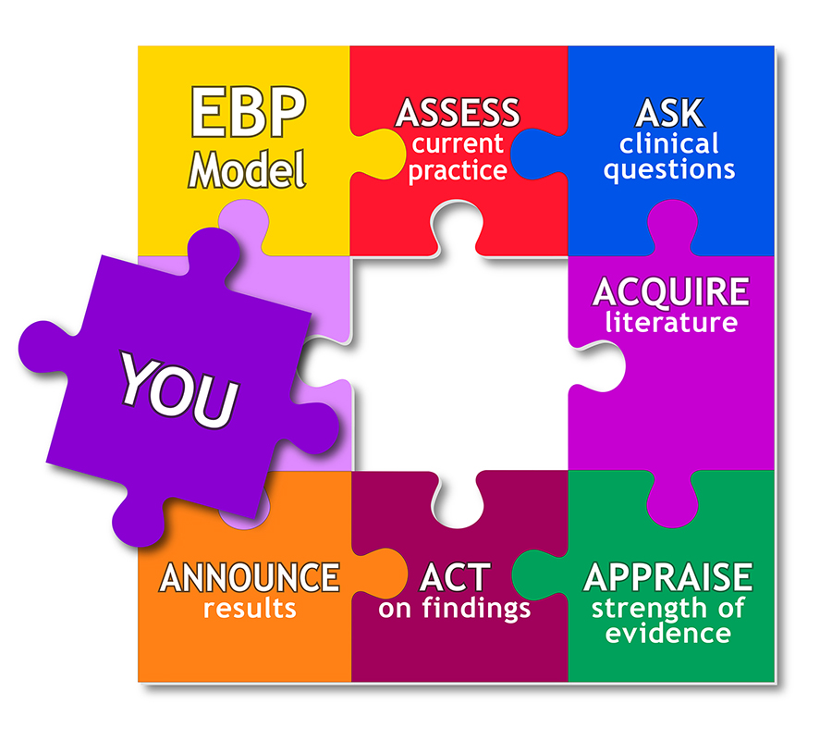
Evidence Based Approaches
WEEK 5- SLIDE
Evidence based Approaches
Critical research skills and the research process within evidence-based approaches.

Slide 2

Aim;
Explain critical research skills and the research process within evidence-based approaches.
Learning outcomes At the end of this lesson students will be able to ;
Explain critical research skills to evaluation of information
Explore the research process within evidence-based approach

Slide 3

ASSESSMENT SUBMISSION
All assignment will be submitted in electronic format and uploaded to LSC Portal on Turnitin
Date assignment set: March 2021
Submission deadline date: 1st June 2021
Return date to students: 28/06/2021
Word Limit: 2500 words
Assessment Weighting Criteria (100%)

Slide 4
What is Research?
We’ve all surely heard the term “research” endlessly. But do you really know what it means?
Research is a type of study that focuses on a specific problem and aims to solve it using scientific methods. Research is a highly systematic process that involves both describing, explaining, and predicting something.

Slide 5

Video activity on research skills
Explain critical research skills within evidence-based approaches.
Developing Research Skills
https://youtu.be/sjGMBBQOONg
This video will introduce you to some of the research skills you'll need.
https://youtu.be/vTkNw3mnryc

Slide 6
Research skills
Ability to search for specific enquiry.
find
collect
Analyse
interpret
Evaluate information that is relevant to the subject being studied.
(Nuigalway.ie, 2019)

Slide 7

Research skills allow you to find information and use it effectively. It includes creating a strategy to gather facts and reach conclusions so that you can answer a question.

Slide 8
What are research skills?
In a nutshell, research skills help us find answers to questions.
Research skills are the ability to search for, find, collect, analyse, interpret and evaluate information that is relevant to the subject being studied.
Research shapes the future, it teaches us new things and helps us adapt and evolve. Without research, we wouldn't have cars, smartphones or the internet (or this website for that matter!)
Everyone is a researcher
We all research, even if we don't know it.
The internet is a huge part of our lives. Using search engines (like Google) is a way of researching. Whether you're finding cheap flights or a top restaurant, it's all research!

Slide 9

Why do I need research skills?
They enable you to locate appropriate information and evaluate it for quality and relevance
They allow you to make good use of information to resolve a problem
They give you the ability to synthesize and communicate your ideas in written and spoken formats
They foster critical thinking
They are highly transferable and can be adapted to many settings including the workplace

Slide 10
Here are some examples of research questions:
Does smoking cause lung cancer?
Sexual abuse of staff by patients in care homes
Physical and mental abuse in domiciliary care
Neglect of staff in hospitals by management
The impact of funding on being able to safeguard adults effectively
Impact of diabetes on the mental health and emotional wellbeing of individuals
Effects of quarantine on mental and physical health of young and elderly service users in care homes in the UK.
Depression in adults with a chronic physical health problem

Slide 11
Examples of research questions: Cont.…
Emotional and physical distress in a global pandemic: the place of mental health leadership
Exploration of the impact of dementia on individuals in physical, mental and emotional wellbeing in London hospital”
The impact of multiple physical conditions on individuals’ mental health and emotional wellbeing
How corona impact on promoting physical and mental health and emotional wellbeing simultaneously
The impact of obesity on individual's physical, mental health, and emotional wellbeing
Emotional and physical distress in a global pandemic: the place of mental health leadership
How can the use of discriminatory language impact service users?
Exploring the importance of alternative communication when working with individuals with additional needs.
What is the impact of using non-verbal communication with patients who have English as a second language?

Slide 12
Research Skills
We are all researchers! Booking a bus journey or flight, choosing a university course, trying to find the perfect coffee or ice-cream cone – these are all examples of research in everyday life.
Research skills refer to the ability to search for, locate, extract, organise, evaluate and use or present information that is relevant to a particular topic. Academic research is a specific type of research: a process of detailed and methodical investigation into some area of study.
Research skills are our ability to find an answer to a question or a solution to a problem. Research skills include the ability to gather information about your topic, review that information and analyse and interpret the information in a manner that brings us to a solution. Research skills are essential for employees to have in most positions and industries.

Slide 13

Research skills-contd
Research skills are what helps us answer our most burning questions, and they are what assist us in our solving process from A to Z, including searching, finding, collecting, breaking down, and evaluating the relevant information to the phenomenon at hand.
It involves intensive search, investigation, and critical analysis, usually in response to a specific research question or hypothesis. It also usually involves a lot of reading.

Slide 14
Why are Research Skills Important?
Research skills come in handy in pretty much everything we do, and especially so when it comes to the workforce. Employers will want to hire you and compensate you better if you demonstrate a knowledge of research skills that can benefit their company.
From knowing how to write reports, how to notice competition, develop new products, identify customer needs, constantly learn new technologies, and improve the company’s productivity, there’s no doubt that research skills are of utter importance. Research also can save a company a great deal of money by first assessing whether making an investment is really worthwhile for them.

Slide 15
How to develop research skills
Everyone is a natural researcher. Whether you’re looking for the best price on a product or researching a topic for a school project, you’re using research skills. Follow these steps to expand upon those skills:
Make an outline
The first thing you should do when starting any research project is to make an outline to help guide your research.
Your outline should include a plan for the questions you need to research and the information you need to arrive at a decision.
It should also include a plan for how you will divide your research project into manageable parts and a schedule detailing when each piece of your project should be complete.

Slide 16

Searching for information
All research involves the search for credible information that you can analyze and use to arrive at an answer or solution. In the workplace, the information you search for will likely help you complete projects and add value to the company.
For example, you may look for information on how to resolve an organisation issue or identify your patient / service users’ needs.

Slide 17
Gather the Information
Research involves gathering and interpreting information. To answer a question or understand the complexity of an issue, you have to seek relevant information, which helps you develop your own point of view.
It's important to remember, though, that information from outside sources should not stand in for your thinking. Sometimes, people think that gathering information and summarizing it in a paper is all there is to the research process. But finding information is just part of the process.
Research involves applying critical thinking to information, whether it comes from a journal article, a website, or a documentary.
A researcher analyzes the material and develops a perspective on it. The goal is to think critically about the information, not simply repeat its ideas.

Slide 18
Gather the Information
The purpose of your research and the questions you're trying to answer will determine what information is relevant and useful. If you're trying to understand public opinion on an issue, it might be worthwhile to look at news articles and blog entries. On the other hand, such sources may not be appropriate for a formal philosophical argument or a medical study.
Sources used in academic papers might include scholarly journals, books, research reports, government documents, films, comic books, magazines, newspapers, maps, statistics, letters, diaries, dictionaries, musical recordings, and more. It all depends on your purpose.

Slide 19
Taking notes
Note-taking skills involve the ability to gather the most important information being presented to you and summarize it in writing so you can reference it later. Knowing how to take good notes will help you in several ways throughout your career. You will need to take effective notes during training and meetings. You may also need to take notes during interviews, especially if you are the interviewer.
Time management
Time management skills refer to the ability to break down projects into manageable parts, make a deadline-oriented plan and complete each section of your plan by your scheduled deadline. Time management skills involve setting goals, planning, organizing, delegating and prioritizing tasks. Displaying strong time management skills in the workplace can help you complete tasks on deadline, accomplish your goals and advance your career.

Slide 20

Problem-solving
Problem-solving skills refer to the ability to handle difficult situations and overcome complex business challenges. Problem-solving skills involve the ability to break a problem down into its parts, think critically about each element, analyze the information you find and use that information to form an effective solution. Having strong problem-solving skills will help make you a valuable asset to your company and can help you advance your career.
Communicating results
Communication skills refer to the ability to understand the information you receive and present information in a manner others can understand. Communication skills involve active listening, observing and speaking. Research skills require good communication skills to present the results of your research.

Slide 21
Know your sources
The internet has made locating information more accessible, but not every source is credible. It is important to know how to find reliable sources and analyze information to determine whether or not it is credible. To ensure you are gathering accurate information, try to verify information from one source by using another. Locate the original information source to verify its reliability.
Learn to use advanced search techniques
When you are using the internet for research, most search engines allow you to use advanced search preferences to customize your search results. These search techniques will help you find the information you are looking for from credible sources more efficiently.

Slide 22
Practice
One of the best ways to develop any new or existing skill is to practice. You can practice developing research skills by creating small research projects for yourself to work on that can help you with a current life event.
For example, if you are planning a vacation, you can practice researching different activities and prices of hotels and transportation. If you are looking for a job, you can practice researching information about different positions and companies.

Slide 23
More examples of research skills
Research skills refer to the collection of several separate skills that help you find and review information and arrive at a decision. Research skills in the workplace include:
Searching for information
Attention to detail
Taking notes
Time management
Problem-solving
Communicating results

Slide 24

More Examples of research skills
Here's a list of some research skills :
Report writing
Data collection
Analysis of information from different sources
Finding information off the internet
Critical thinking
Planning and scheduling
Interviewing
Critical analysis

Slide 25

How can you gain research skills?
You can research using tools and methods like:
The internet
Books
Interviews
Surveys
Journal
Experiments
Articles
Studies

Slide 26
How can you demonstrate your research skills?
As a graduate, It's likely you've done a lot of researching! For example during:
Your dissertation
Assignments
Group projects
Individual project
Experiments

Slide 27
Critical Questions
What information do I need to address this question or understand this topic?
How much information do I need?
Where can I find this information?
How do I know this information is reliable and authoritative?
Is this information relevant to my purpose?
Who is the audience for this information?
What perspective does this information come from? What are its biases?
Is the information current enough?

Slide 28

What is citing and referencing?
When you use ideas or information from sources such as books, journals, webpages, film or other materials in your writing you need to show in your document where the information came from. For further information see the explanation in Cite Them Right Online
Why do I need to do it?
Citing and referencing your work correctly is essential. If you acknowledge the work of others you are acting with academic integrity and taking steps to avoid plagiarising someone else's work. You are also allowing your reader to trace your line of research.

Slide 29
How to Structure an Evidence-based Report: LO 3
An evidence-based report is structured in sections that do the following:
Introduction (also called Background or Problem): describe the problem and its importance (prevalence, severity, cost implications, impact on function, aesthetics, etc.).
Aim: state the question(s) to be answered in a format that can be searched. Hypotheses are sometimes also included.
Methods: describe the search strategy used to collect the evidence; describe the criteria used to include or exclude evidence.
Results: state the yield of the search strategy(ies); show numbers of papers rejected at each stage (title, abstract, full copy); show final numbers of studies included and critical appraisal score(s); an evidence table is often included;
Literature review : critically analyse the findings; the main argument is presented here;
Conclusions: draw conclusions from your analysis of the literature and draw an overall conclusion about the quality of the evidence; state the “best” answer to the question(s).

Slide 30
Using research skills for EPA
Here are a few ways you can incorporate your research skills in the workplace:
Prepare. Before you start a new project, take time to set goals and ensure you have everything you need to complete the research.
Use various sources. Utilizing several different sources when performing research at work is a good way to ensure you find the information you're looking for and that the data is accurate and agrees with other sources.
Consult with coworkers. Comparing your findings with colleagues is an important part of the research process and ensures that the same information is being found and utilized across departments.
Communicate. Practicing good communication is an essential component of the research process. Make it a point to regularly incorporate some form of communication into your daily duties, whether it be writing a progress report or sending an email with relevant research-related information included.

Slide 31
https://www.nuigalway.ie/academic-skills/readingandresearch/#
https://library.soton.ac.uk/sash/introduction-to-research-skills
https://www.indeed.com/career-advice/career-development/research-skills
Read more: Problem-Solving Skills: Definitions and Examples
Read more: Communication Skills: Definitions and Examples

